Slide 1
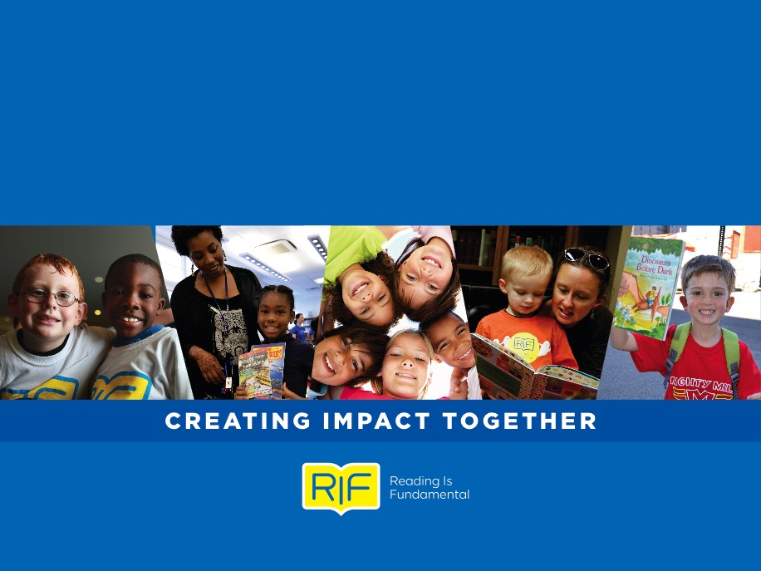
Reading Is Fundamental

Slide 2
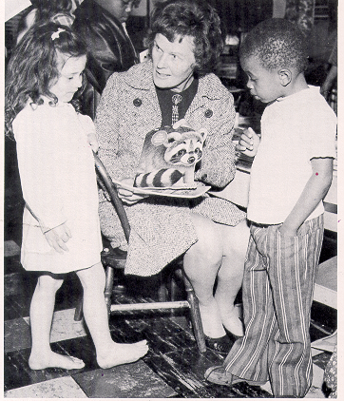
RIF HISTORY
Founded in 1966 in Washington, D.C.
RIF has provided more than 412 million books to 40 million RIF kids and engaged more than 1 million volunteers over 50 years, inspiring generations to read, learn and grow

Slide 3
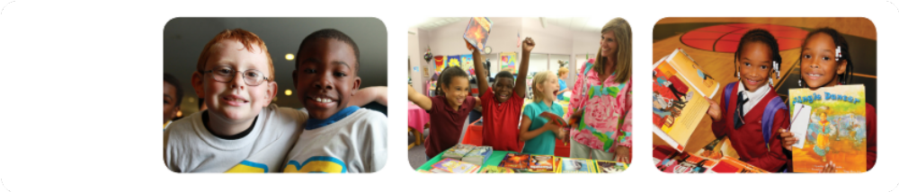
WHO WE ARE
Reading Is Fundamental is the leading voice for children’s literacy. We address the alarming literacy crisis in America today through strong leadership, quality content, and an active and engaged community.
RIF creates measureable solutions to ensure every child has the opportunity to read and succeed.

Slide 4

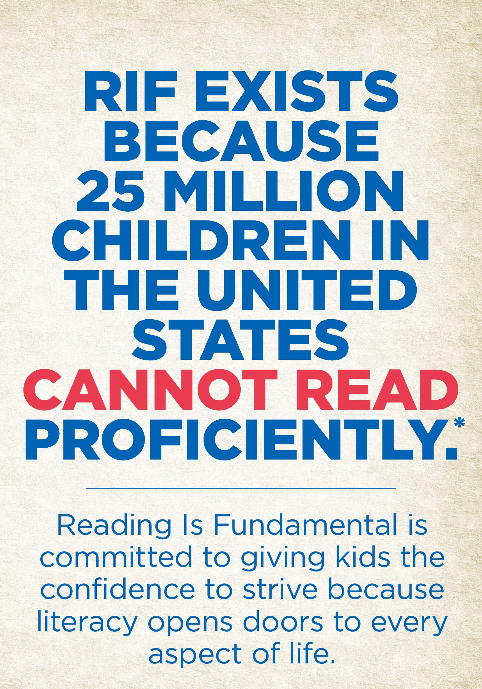

Slide 5
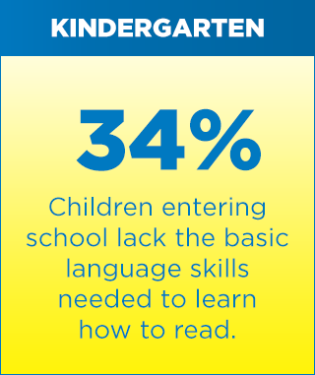
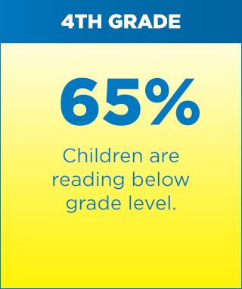
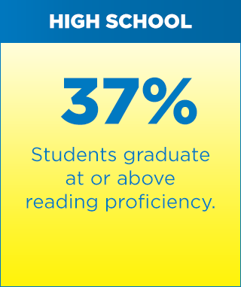
THE LITERACY CRISIS
The facts tell a difficult story for American children:

Slide 7
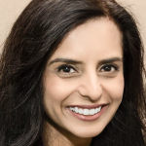
RIF Makes a Difference
When Sangita Patel and her family immigrated to the United States, sadly the first thing to go, were books. They spent two years staying with relatives before they could settle in to their own home. And books were a luxury too expensive to afford and too heavy to transport.
It was 1983 when 11-year-old Sangita entered her school library. In front of her were piles and piles of brand new books. Like music to her ears, the teachers told her she could choose one... one to take home … for free.
“I’ll never forget taking home my Reading Is Fundamental book,” Sangita said. “It literally opened up a new world to me. I read it cover to cover! It helped me adjust to my new surroundings, but ended up doing even more than that. It opened the door to the written word, a world that’s now not only my passion, but also my career.”

Slide 8
RIF Makes a Difference
“Twenty years ago, my mother asked me to help her get books into the hands of kids in need. As a teacher, I understood all too well the value of books and the importance of giving back.
Today, I serve as co-president of RIF of Northern Virginia and my mother, now 88 years young, still sits on our board. My two grown daughters have also joined the RIF family as we all work side by side to ensure that less-fortunate children have the opportunity to choose new books to call their own.
At a recent RIF book event, a young girl asked if I’d sign her RIF book. Before I knew it, other children ran to get behind her in line. After I explained that I wasn’t the author, the young girl said, “But you’re the one who gives us books.”

Slide 9

RIF Makes a Difference
While packing to move, Ketan found a well-read copy of The Forgotten Door by Alexander Key among the stacks of books on his floor. He opened the book to show his wife a note his 6th grade teacher, Mrs. Limbaugh, had written in it for him.
Ketan is now an Electrical Engineer with a master's degree from MIT but when Mrs. Limbaugh wrote that note, he was just a student in Missouri receiving a new book from Reading Is Fundamental.
Why did he decide to keep it these past 29 years? Because it was his. It was one of the first books Ketan actually owned rather than borrowed from the library. “We came from a less fortunate background and RIF opened the door to a whole new world of reading for me.”

Slide 10
Kappas Makes a Difference
Use this slide to showcase your local impact with RIF- whether a Reading Is Key event or local fundraising event for RIF, share a few highlights and a photo to shine a spotlight on how your chapter makes difference!

Slide 11
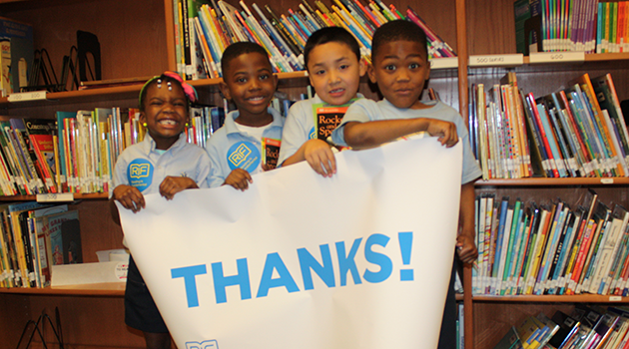

For additional information, please visit RIF’s website at www.rif.org.
And, check out RIF on social media

